Slide 1
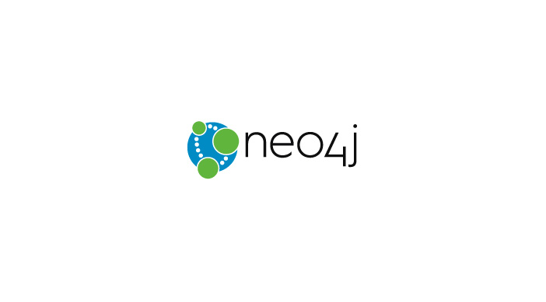
A New Perspective To NoSQL

Slide 2
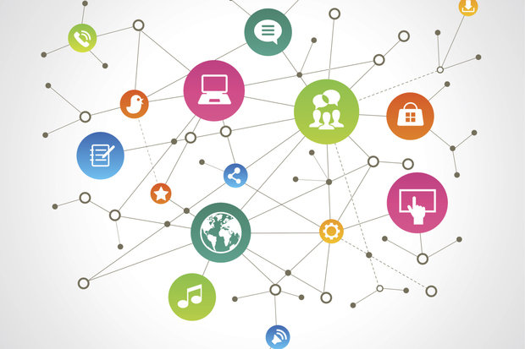
A Graph is Connected Data

Slide 3

NODES:
The objects in the graph
Can have name-value properties
Can be labeled
RELATIONSHIPS:
Relates nodes by type and direction
Can have name-value properties

Slide 4
Neo4j is a GRAPH database:
A schema-free property graph
Perfect for complex, highly connected data
Reliable with real ACID transactions
Scalable
Fast with more than IM travels/second
Server with REST API , or embedded on the JVM
Higher performance with higher availability

Slide 5
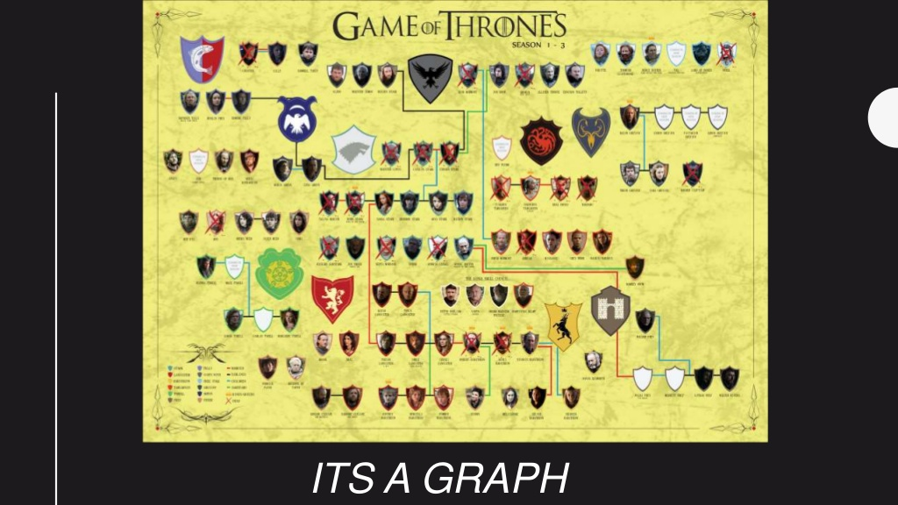
Game of Graphs

Slide 6
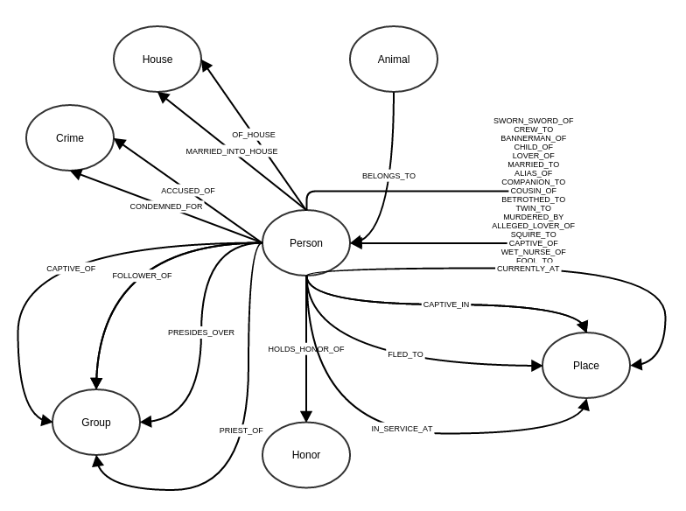
Nodes and relationships

Slide 7
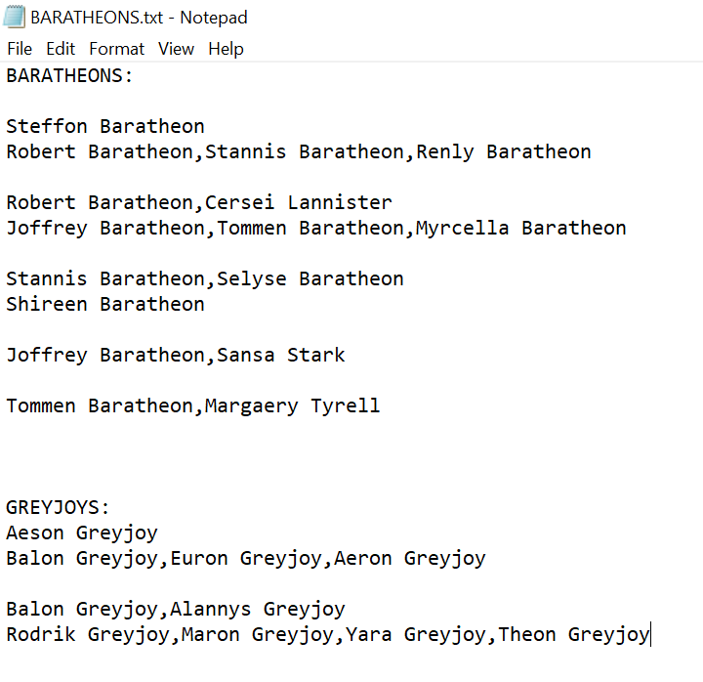
Data set:

Slide 8
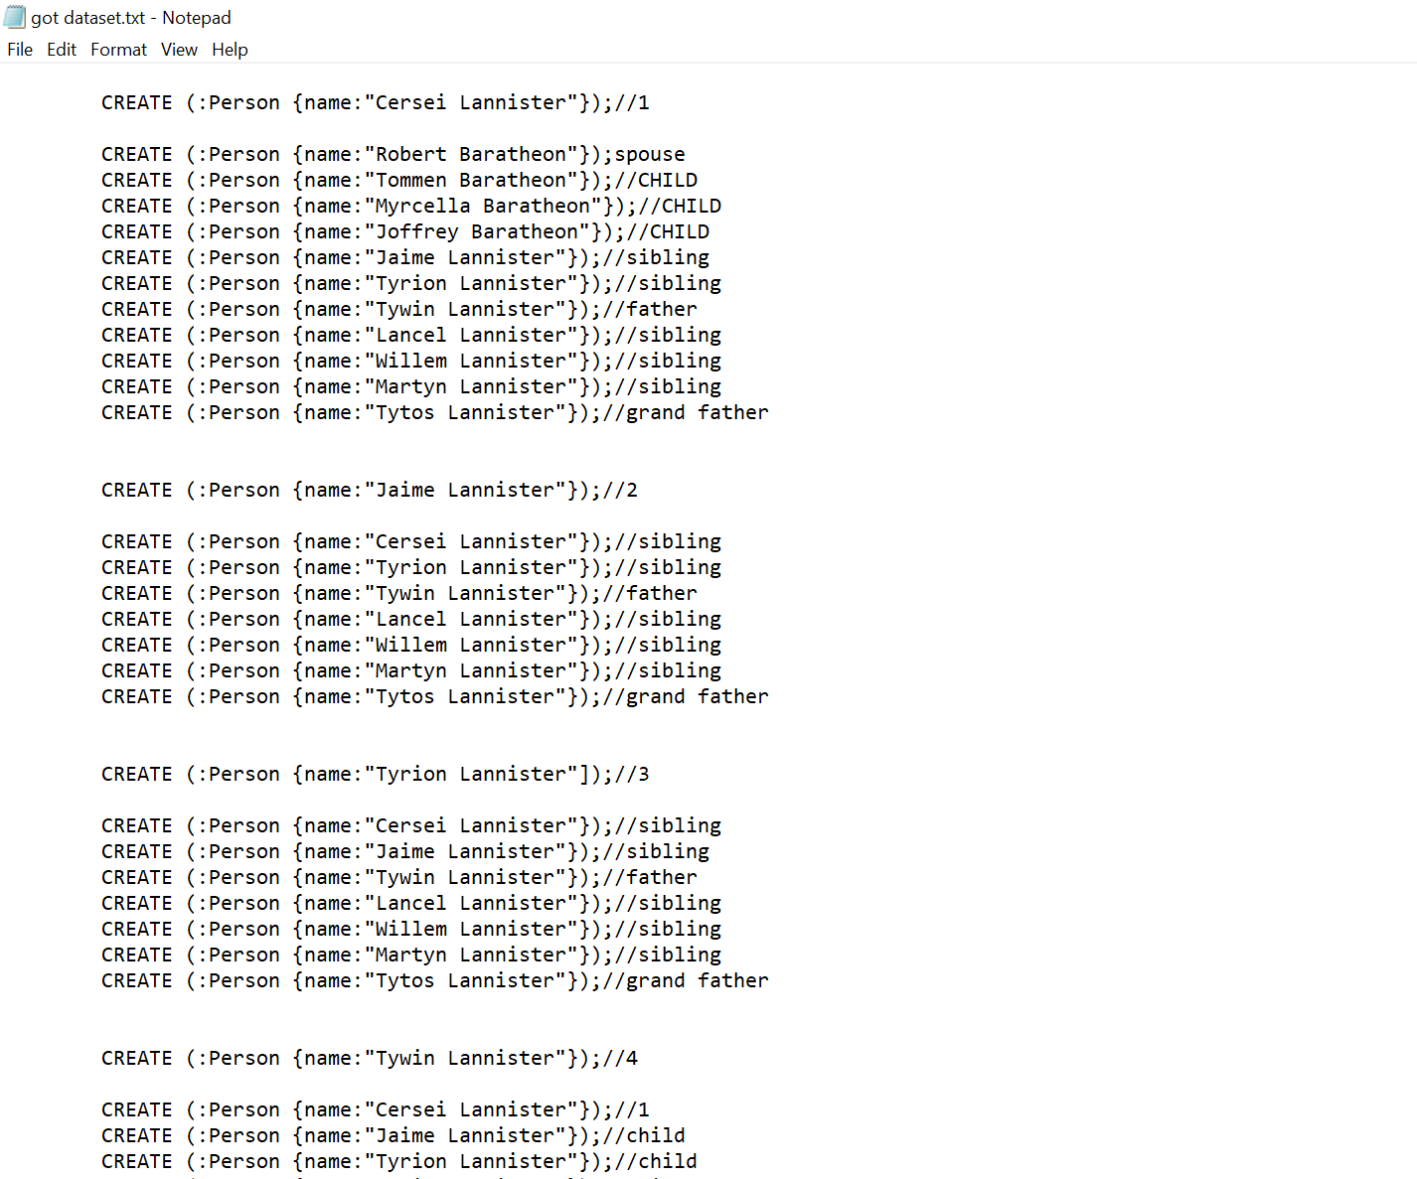
Data set:

Slide 9
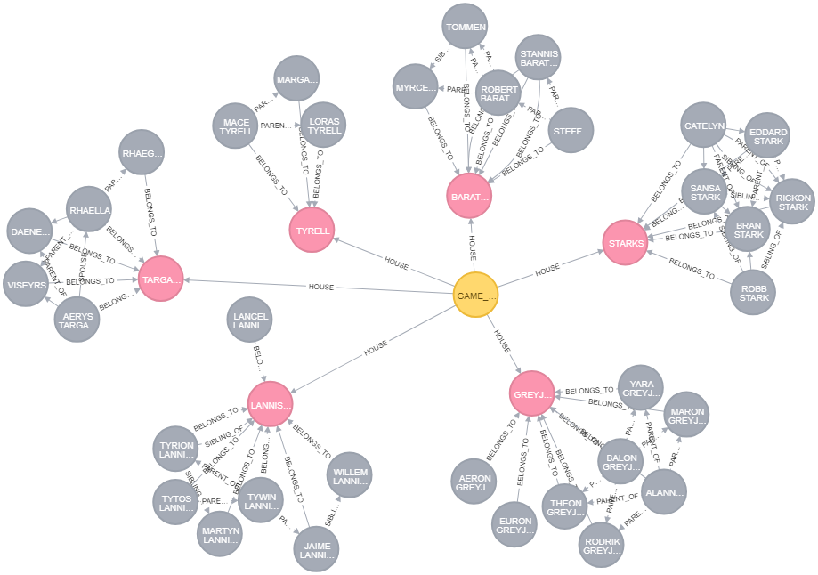
Game of Thrones Graph:

Slide 10
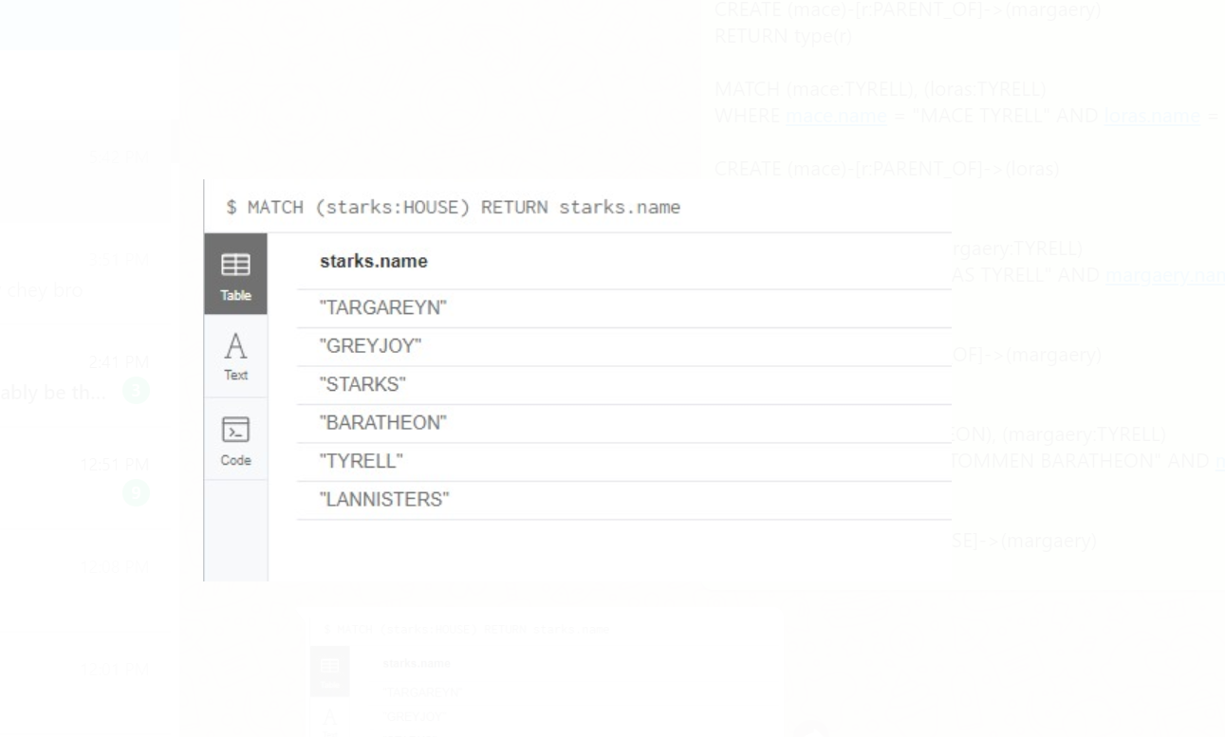

Slide 11
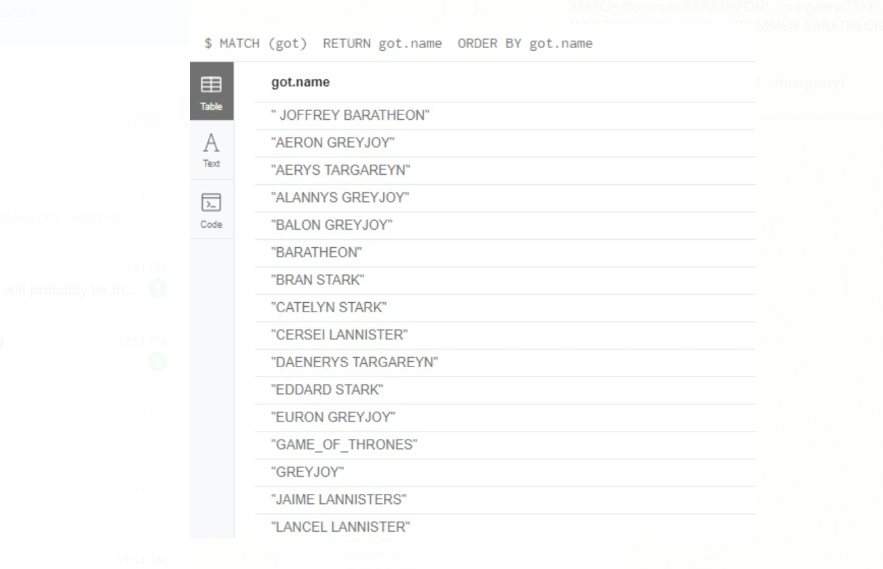

Slide 12
